Slide 1




Final Presentation
12/07/2022
42 North Dental Field Project Team

Slide 2
Problem Overlook
Data Processing
Appointment Miss & Cancel Rate
Loyalty Analysis
Active & Lapse Patient Analysis
Suggestions
AGENDA

Slide 3
Problem Overlook
Problems:
Appointment Missed and Cancelled (M/C)
How M/C rate relate to patient features and different offices?
Patient Loyalty and Active patient:
How to define Loyalty and Active patient?
How do patients behave differently?
Solutions:
Machine learning models and Tableau Dashboards
Goal: 42ND will have a better understanding of their customers and business patterns.

Slide 4
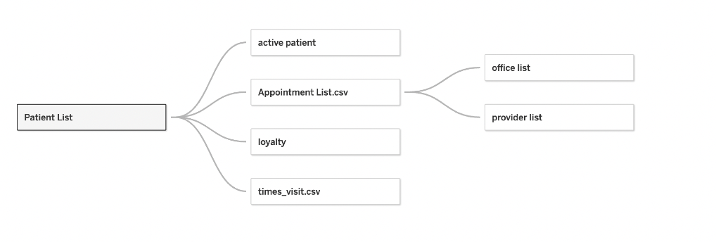
Data Processing
Table relationships
We further used the datasets we were given defined active patient, loyalty and how many times each patient visited. And add these information in the existing dataset.

Slide 5
Data Processing
Import Data
Define new data points
Merge data
Data Standardization
Fill Missing Values
Filter Data

Slide 6
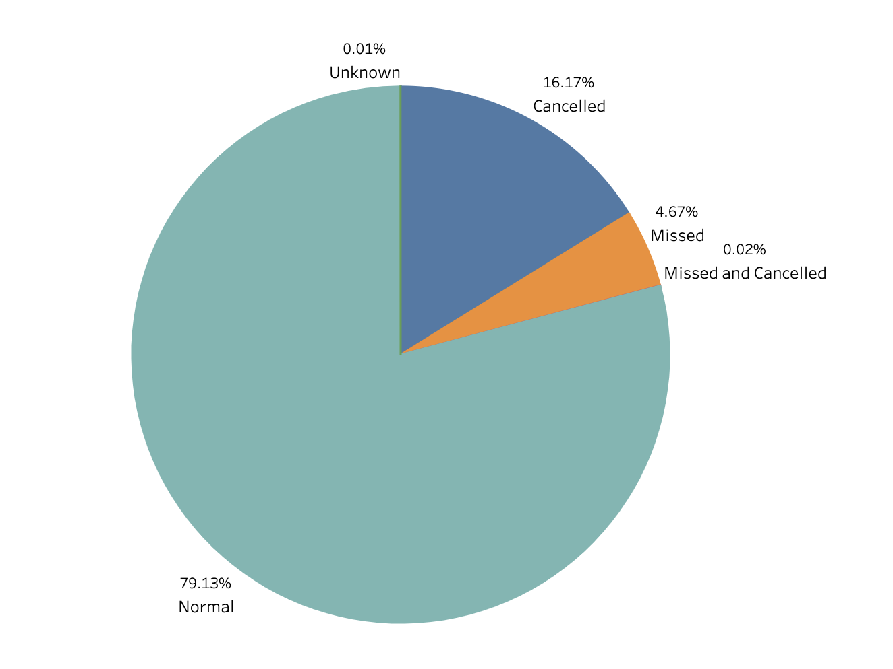
Appointment miss & cancel rate
Overview
M/C rate is approximately 20%.
Missing & Cancel rate:
Correlations among patients features
Distribution in each offices
Time trend
Dashboard Link: https://public.tableau.com/app/profile/sara7117/viz/FinalMCRate/Fianl_MCRate

Slide 7
Appointment miss & cancel rate
Dashboard Link: https://public.tableau.com/app/profile/sara7117/viz/FinalMCRate/Fianl_MCRate
Our conclusions
Operations with Orthodontist, Director, Oral Surgeon has higher M/C rate
M/C rate in the office of Newbury, Malden, Braintree are higher than the other offices
M/C rate of Female is higher than male and uni-sex
M/C rate of people from 30-40 years old is higher than the other age groups
All plots in dashboard are doing calculations and comparisons over all the categories, while some plots show on ppt are doing calculations and comparisons within their own category, so the plots might looked different and with different numbers

Slide 8
Loyalty Analysis
Definition of Loyalty patients
Loyal patient = comes every 9 months
For example, patient A visited 4 times within 4 years, A’s frequency equals 4/(4*365) < 1/270, and thus, A is a not a loyalty patient
All plots in dashboard are doing calculations and comparisons over all the categories, while some plots show on ppt are doing calculations and comparisons within their own category, so the plots might looked different and with different numbers
Notes:
We calculated their total operation times, and the interval between their first_visit_date and most_recent_visit_date, then used the total times/time_interval to calculate their frequencies, when frequency > 1/270, the patient is a loyal patient.

Slide 9
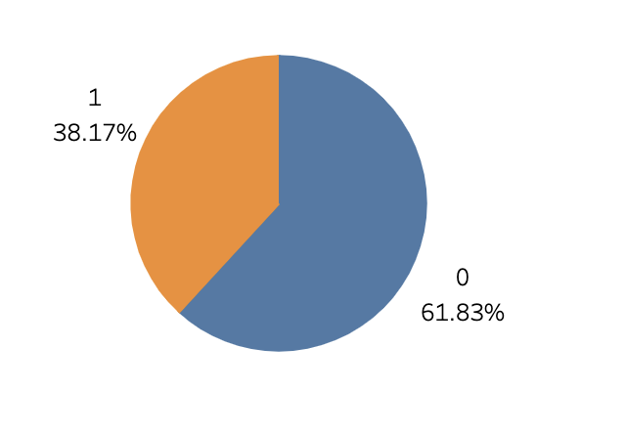
Loyalty Analysis
Loyalty Distribution
Patient loyalty:
Impact on patients features on loyalty
Distribution in each offices
Random Forest : Feature importance
1: Loyal
0: Disloyal
Dashboard Link: https://public.tableau.com/app/profile/sara7117/viz/Final_patientloyalty/Dashboard2
All plots in dashboard are doing calculations and comparisons over all the categories, while some plots show on ppt are doing calculations and comparisons within their own category, so the plots might looked different and with different numbers

Slide 10
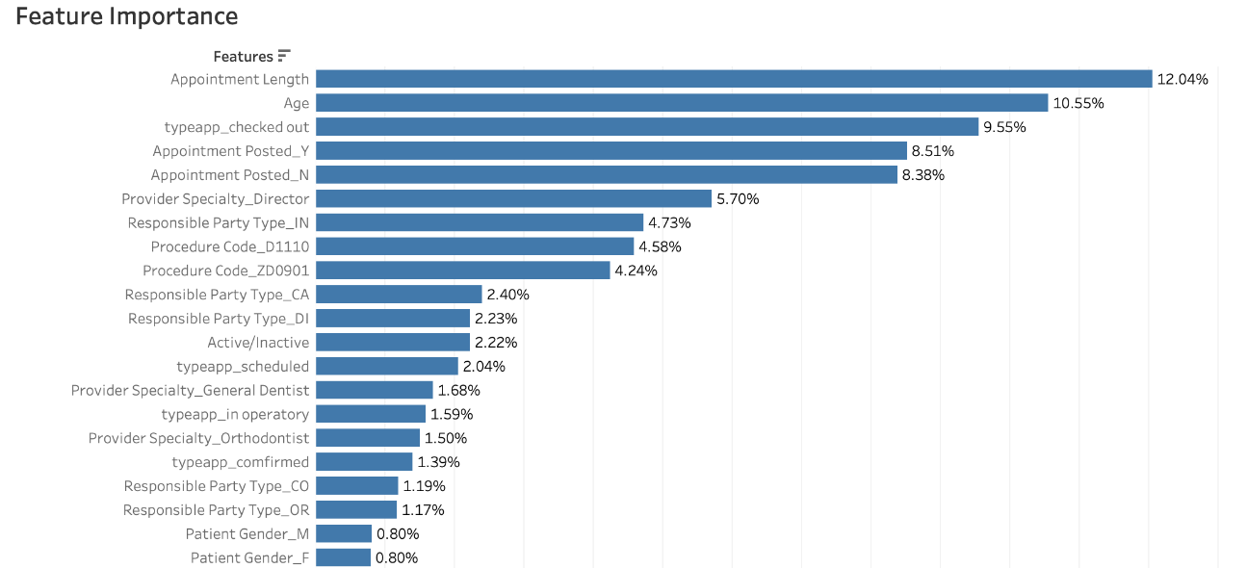
HTML Link: https://github.com/Sarashang1/42-ND/blob/main/d%233%20(1).ipynb
Loyalty Analysis
Feature importance by machine learning
The most important features are appointment length, age, appointment type and specialty (director)
All plots in dashboard are doing calculations and comparisons over all the categories, while some plots show on ppt are doing calculations and comparisons within their own category, so the plots might looked different and with different numbers

Slide 11
Loyalty Analysis(Gentle Dental)
Dashboard Link: https://public.tableau.com/app/profile/sara7117/viz/Final_patientloyalty/Dashboard2
Our conclusions
Analysis methods:
Formula 1: number of loyalty patients in each group / total loyal patients
Formula 2: for each group, loyal / (loyal + disloyal)
Conclusion Based on Formula 1:
Gender: Female are compose the larger percentage of loyal patients
Age: Patients between 20-30 and 30-40 are the most loyal patients
Office: Newbury, Chelmsford, Cambridge have the largest stake of loyal patients
Responsible party type: Insurance leads with 50%

Slide 12
Loyalty Analysis(Gentle Dental)
HTML Link: https://github.com/Sarashang1/42-ND/blob/main/d%233%20m.ipynb
Our conclusions
Analysis methods:
Formula 1: number of loyal patients in each age group / total loyal patients
Formula 2: for each group, loyal / (loyal + disloyal)
Conclusion Based on Formula 2:
Gender: Female, Male, and Uni-sex patients have roughly the same loyalty levels
Age: People between 20-30 and 30-40 tend to be the most loyal
Office: Cambridge, Wakefield, Braintree, Jamaica Plain, Beverly
Responsible party type: Insurance more than cash

Slide 13
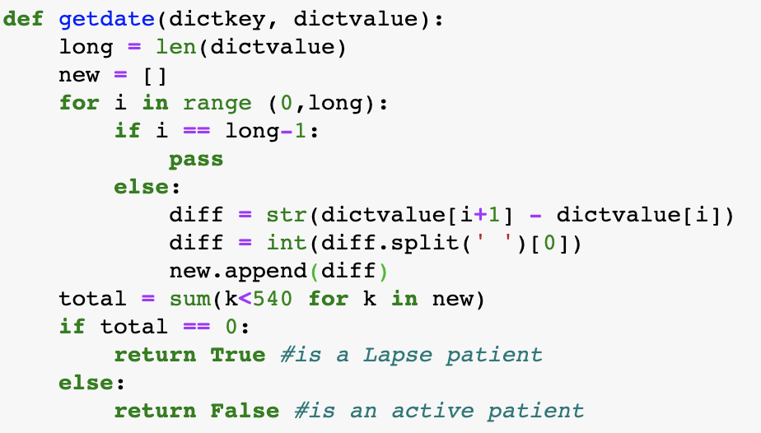
Active patient analysis
Definition of Active and Lapse patient
Active patient:
Visits more than once in any 18-month time interval
Lapse patient:
Visits less than once in any 18-month time interval
Notes:
Lapse patient only visited our office once in 18 months, all the visit time intervals for active patients is less than 18 month (in other words, an active patient visited us more than once in 18 months)
For example, patient A visited 3 times in 12/02/2015, 10/03/2017, and 12/10/2020, A is a lapse patient (All A’s time interval are more than 18 months)
Patient B visited 4 times in 12/02/2015, 8/03/2016, 10/5/2017, and 4/01/2022, B is a lapse patient

Slide 14
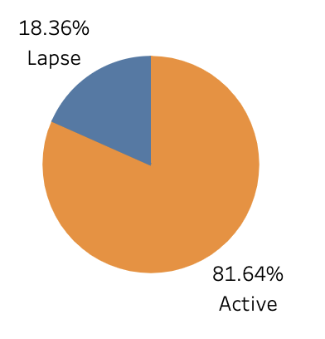
Active patient analysis
Overview
Active patient:
Impact on patients features on loyalty
Distribution in each offices
Visit time distribution
Insurance Vs Cash in different offices
Dashboard Link: https://public.tableau.com/app/profile/sara7117/viz/Final_activepatient/Dashboard1
Notes:
Lapse patient only visited our office once in 18 months, all the visit time intervals for active patients is less than 18 month (in other words, an active patient visited us more than once in 18 months)

Slide 15
Dashboard Link: https://public.tableau.com/app/profile/sara7117/viz/Final_activepatient/Dashboard1
Active patient analysis
Definition of Active and Lapse patient
Active patients characters:
Responsible party type: Insurance 57.45% and Cash 27.09%; Preference is to pay by insurance
Age: 20-30
Gender: Female
Office: Newbury, Chelmsford, Cambridge
Visit times: The majority of active patients visit from 2 to 10 times

Slide 16
Dashboard Link: https://public.tableau.com/app/profile/sara7117/viz/Final_activepatient/Dashboard1
Active patient analysis
Our conclusions
Active patient preferred Payment type, categorized by office
Insurance | Cash
Newbury | Manchester
Chelmsford | Nashua
Braintree | Newbury
Worcester | Cambridge
Malden | Quincy
Cambridge | Natick

Slide 17
Data is messy, could collect more relevant data and let them be more structured.
Collect provider specialty when patient make appointment
Update and delete irrelevant data
Suggestions
Notes:
patient visit time update

Slide 18
Appendix
Dashboards:
https://public.tableau.com/app/profile/sara7117/viz/FinalMCRate/Fianl_MCRate
https://public.tableau.com/app/profile/sara7117/viz/Final_patientloyalty/Dashboard2
https://public.tableau.com/app/profile/sara7117/viz/Final_activepatient/Dashboard1
Link to codes:
https://github.com/Sarashang1/42-ND/blob/main/42%20ND%20deliverable%20%231%201.ipynb
https://github.com/Sarashang1/42-ND/blob/main/d%232%201.ipynb
https://github.com/Sarashang1/42-ND/blob/main/d%233%20m.ipynb
https://github.com/Sarashang1/42-ND/blob/main/D4%20(2).ipynb

Slide 19
THANK YOU
12/07/2022
42 North Dental field project team

